Slide 1
7
Basic Elements of Planning

Slide 2
Organizational Goals
An idea of the future or desired result that a person or a group of people envision, plan and commit to achieve

Slide 3
Purposes of Organizational Goals
Provide guidance
Promote good planning
Serve as sources of motivation
Mechanism for evaluation and control

Slide 4
Kinds of Goals by Levels
Vision
Strategic Goals
Tactical Goals
Operational Goals
Notes:
Vision: A vision statement is an inspirational statement of an idealistic emotional future of a company or group. Vision describes the basic human emotion that a founder intends to be experienced by the people the organization interacts with
Strategic goal: a goal set by and for top management of the organization.
Tactical goal: set by and for middle managers of the organization.
Operational goal: set by and for lower managers of the organization.

Slide 5
Kinds of Goals by Time Frame
Long Term goals (5 Years or More)
Intermediate Goals (1-5 years)
Short Term Goals (Less than1 year)
Vision
Strategic goals
Tactical Goals
Operational Goals

Slide 6
Responsibilities for Setting Goals
Planning Staff
Planning Task Force
BoD
CEO
Executive Committee
All Managers

Slide 7
Organizational Planning
A plan is typically any diagram or list of steps with details of timing and resources, used to achieve a goal.

Slide 8
Kinds of Plans by Levels
Mission
Strategic Plans
Tactical Plans
Operational Plans
Notes:
Vision: A vision statement is an inspirational statement of an idealistic emotional future of a company or group. Vision describes the basic human emotion that a founder intends to be experienced by the people the organization interacts with
Strategic goal: a goal set by and for top management of the organization.
Tactical goal: set by and for middle managers of the organization.
Operational goal: set by and for lower managers of the organization.

Slide 9
Kinds of Plans by Time Frame
Long Term Plans (5 Years or More)
Intermediate Plans (1-5 years)
Short Term Plans (Less than1 year)
Mission
Strategic Plans
Tactical Plans
Operational Plans

Slide 10

The Planning Function
It is a systematic activity which determines when, how and who is going to perform a specific job.
A detailed program regarding future courses of action.
Answering 5Ws and 1H

Slide 11
What is to be
accomplished?
The planning
function
consists of:
How is it to be
accomplished?

Slide 12
Objectives
Actions
Planning
has 4
elements:
Resources
Implementation

Slide 13
Why Is Planning Important?
What
has to
be done
A task can not be
accomplished if the
manager is not
aware of:
How is
it to be
done
When is
it to be
done

Slide 14
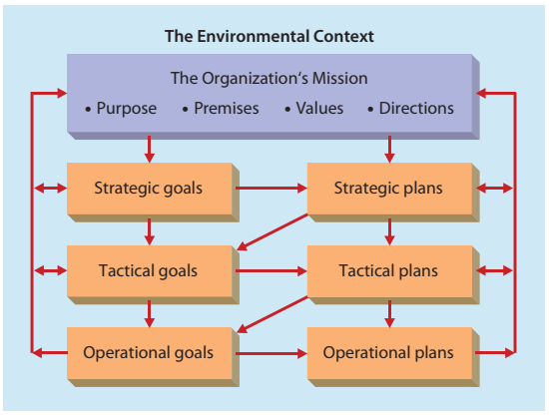
Flowchart of Planning Function
The Organization’s Vision

